Slide 1
How the SEAL Kit Works
Paul Kempler
KICKOFF!
09/29/2018

Slide 2
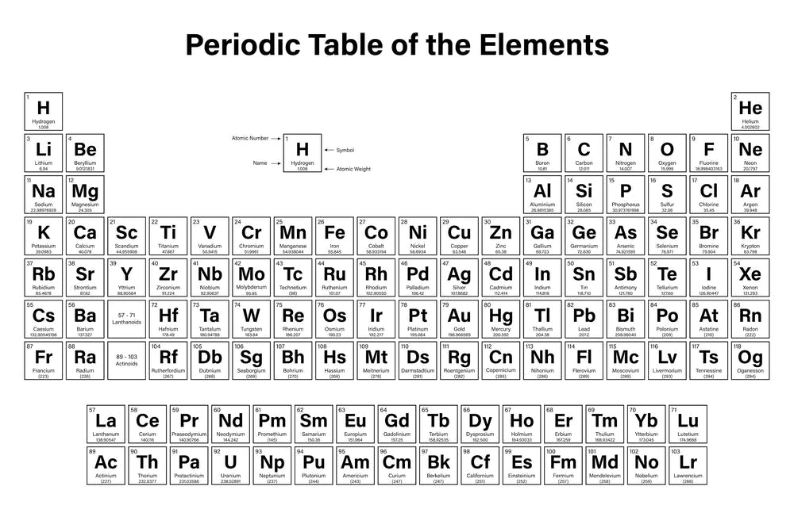
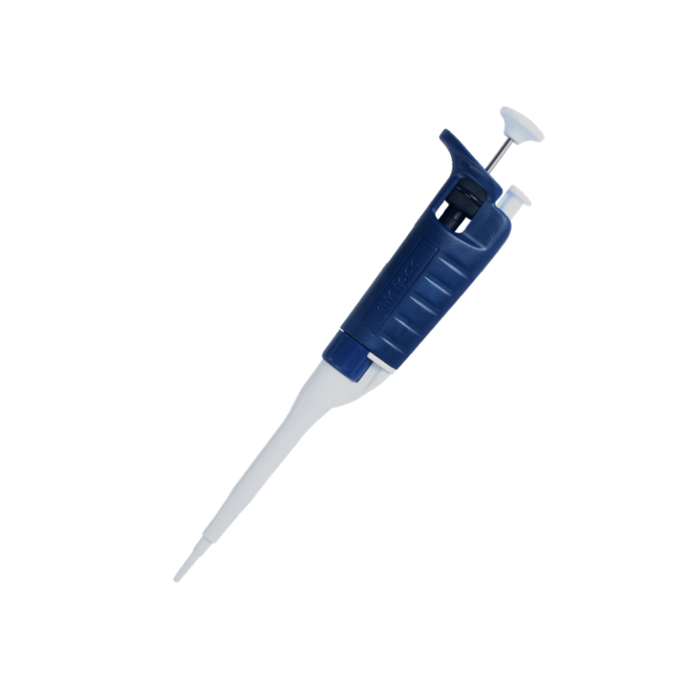
Spotting Plates
Prepare solutions with care
Be curious, be bold, and be creative!
Mix well!

Slide 3
So you’ve made a metal oxide…
500 Degrees

Slide 4
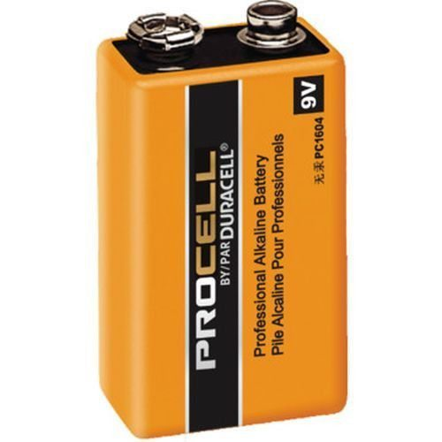
Does it oxidize water?
4 H⁺ + 4 e⁻ -> + 2 H₂
(-)
(+)
2 H₂O -> O₂ + 4 H⁺ + 4 e⁻
2 H₂O -> 2 H₂ + O₂
H₂O
1.23 V

Slide 5
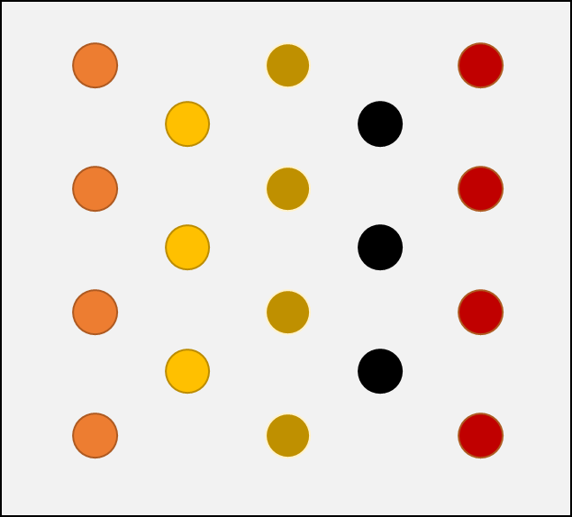
The Circuit
Graphite Rod
Integrator (Silver Box)
The Dish
The Plate
???
Light Box
Nothing happens unless the circuit is complete!

Slide 6
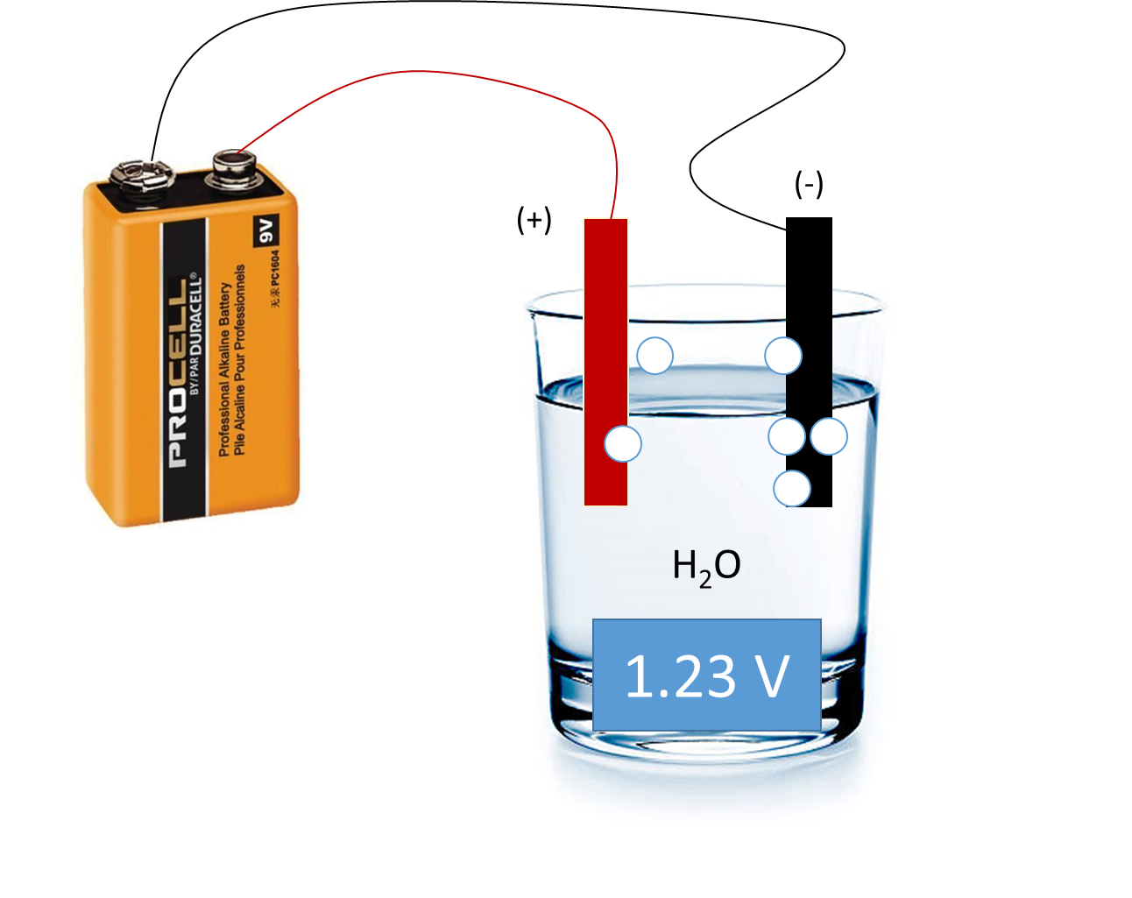
Giving your metal oxide a boost
1.23 V
1.23 V
“Apply a bias”
Spot ☺
Spot ☹

Slide 7
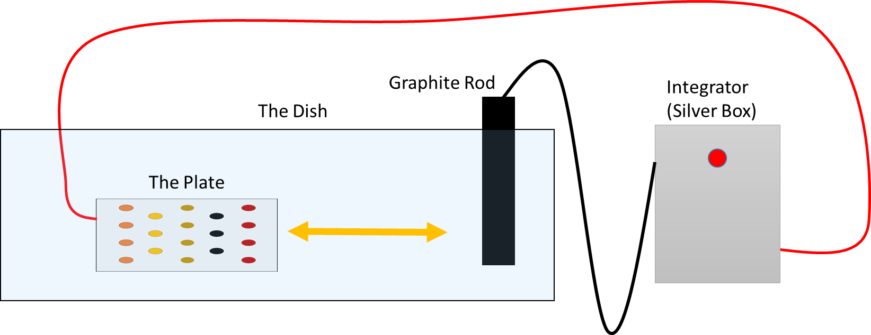
How do we measure oxygen?
“dark scan”
x
x
x
Volts
x
x
x
Time
“Measure the dark current”

Slide 8
How do we measure oxygen?
LIGHT Scan
Light on
x
x
Volts
x
x
x
x
Time
“Perform a scan”

Slide 9
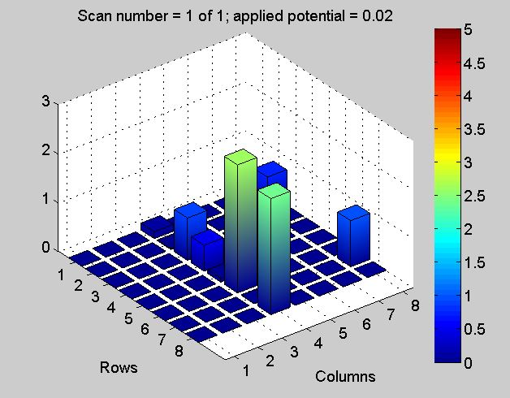
The SEAL Kit Data
“Perform a scan”
Light on
x
x
Volts
x
x
x
x
Time
Potential Hit?
A good experiment has lots of controls and few variables

Slide 10
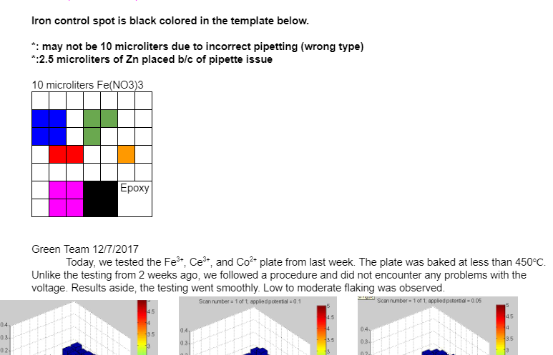
You’re part of a community!
Is the experiment repeatable?
Interpret your data, and share!
San Marino HS Notebook 2017-2018

Slide 11
Good Luck!

