Slide 1

NSF CCI Solar
Solar Energy Activity Laboratory
SEAL Kick-Off 2014
September 20, 2014 – Beckman Institute, Caltech

Slide 2


Harnessing the sun’s energy: how we can learn from nature
Dr. James D. Blakemore
Center for Chemical Innovation in Solar Fuels
Harry B. Gray Research Group
Saturday, September 20, 2014

Slide 3
Outline
Motivation for our work
Why solar?
Natural photosynthesis
  Energy conversion and storage
Artificial photosynthesis
  Introduction to some aspects of catalysis

Slide 4
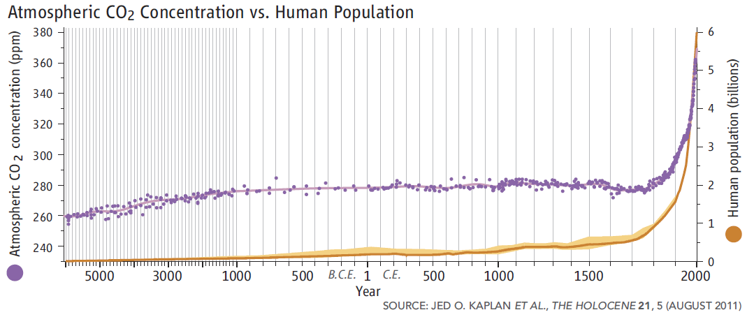
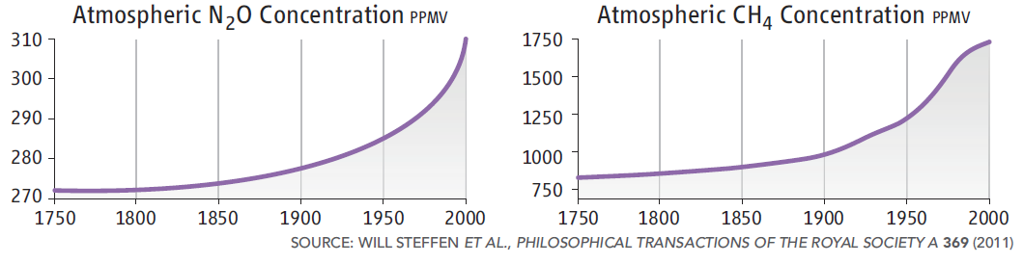
Motivation: Climate, energy, and geopolitics
Science, 7 October 2011

Slide 5
A mechanism for warming

Slide 6
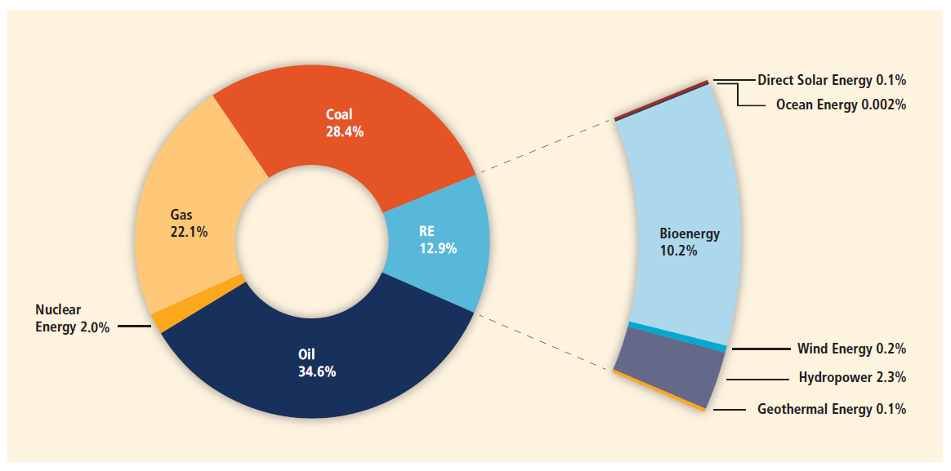
Current energy sources: mostly carbon
Global primary energy supply, 2008.
From: IPCC, 2011: IPCC Special Report on Renewable Energy Sources and Climate Change Mitigation.

Slide 7
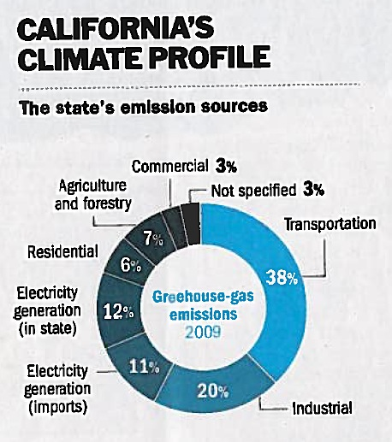
Transportation is a major driver of emissions
Bryan Walsh, Time Magazine 2013, 181, B1-B4 (4 Feb 2013).

Slide 8
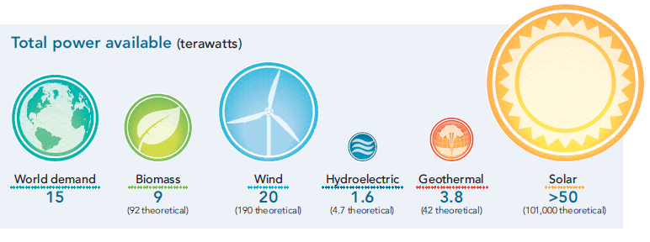
Let the sunshine in!!
Conclusion: We need cheaper, more efficient solar energy conversion and storage!
Cho, Science, 13 August 2011

Slide 9
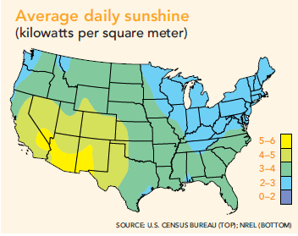
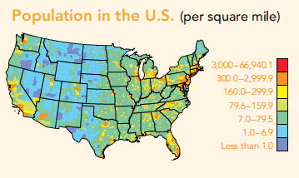
Limitations
Sunlight is not necessarily “strong” in areas of high energy use (cities and regions of high population), thus
energy storage and transport a key issue.
Cho, Science, 13 August 2011

Slide 10
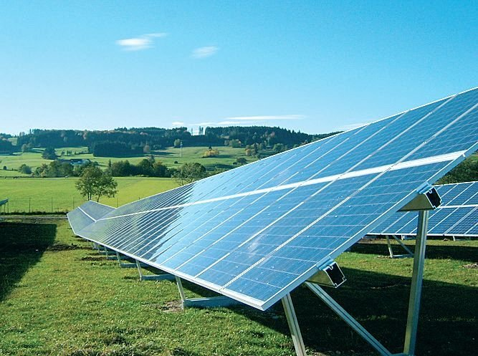
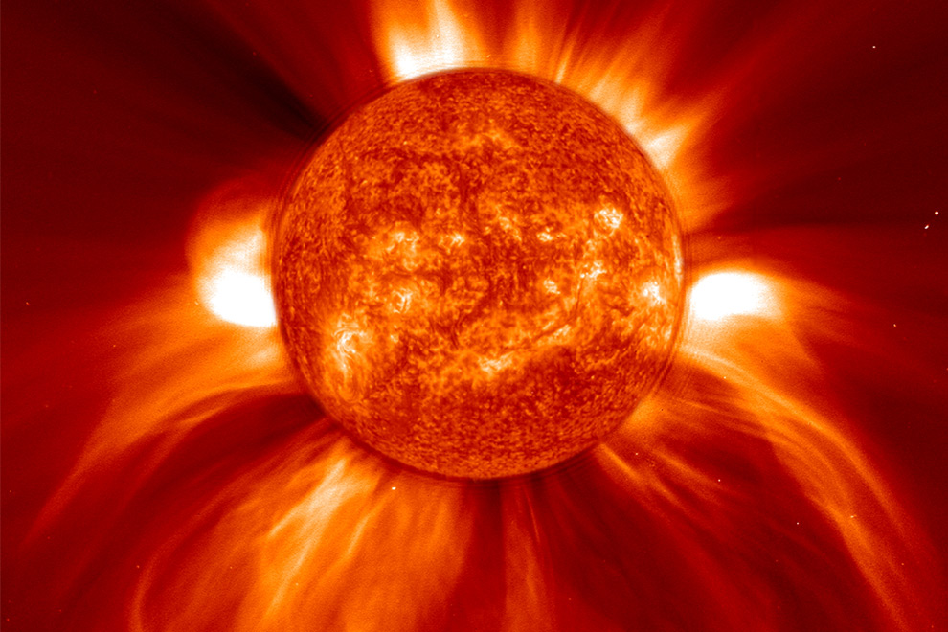
Concentrate and Store
Solar Energy is:
Abundant
but
Diffuse
and
Intermittent
“Those who cannot store will be in the dark after four.” –Nate Lewis

Slide 11
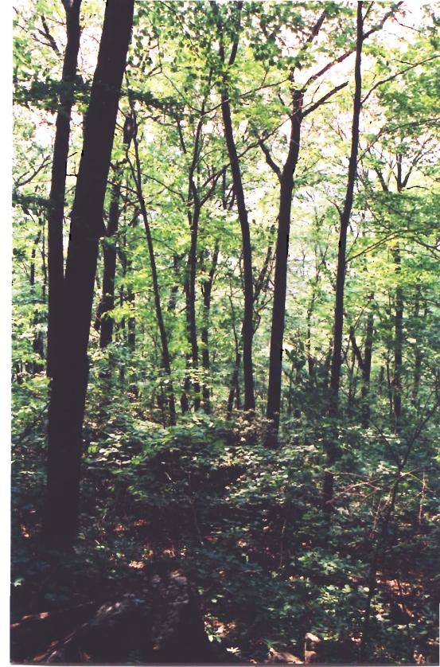
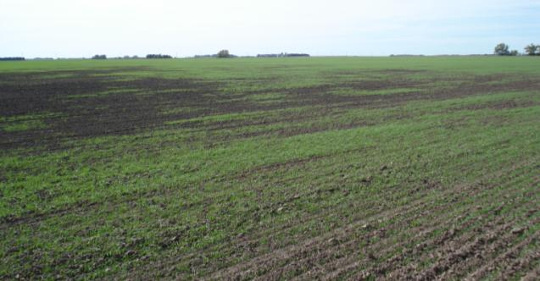
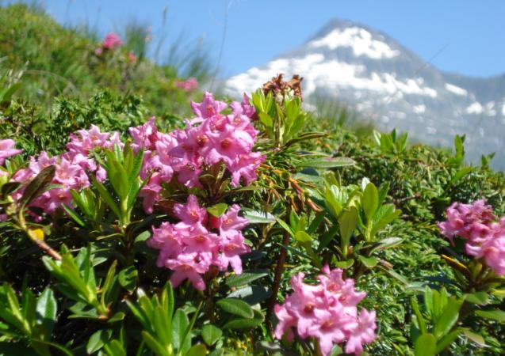
Natural Oxygenic Photosynthesis
6 CO₂ + 6 H₂O + light → C₆H₁₂O₆ + 6 O₂
Water oxidation: 2 H₂O + light → O₂ + 4 H⁺ + 4 e⁻
CO₂ reduction: 6 CO₂ + 24 H⁺ + 24 e⁻ → C₆H₁₂O₆ + 6 H₂O
near Stafford, Kansas
Sleeping Giant State Park, Conn.
Lucmagnier Pass, Graubünden-Ticino, Switzerland

Slide 12
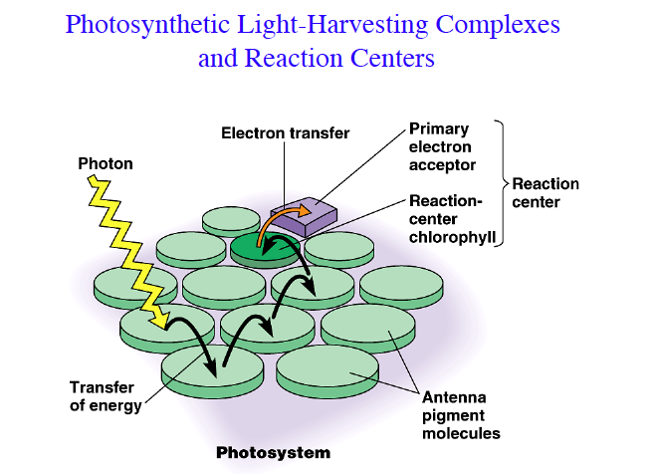
Courtesy: Gary Brudvig, Yale

Slide 13
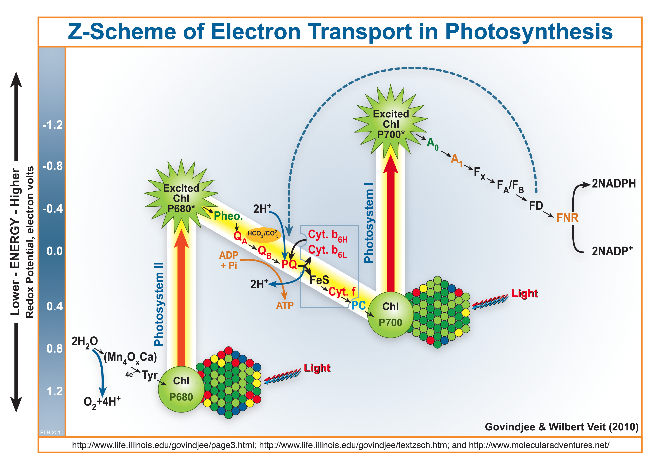
Energy conversion: photochemistry and catalysis

Slide 14
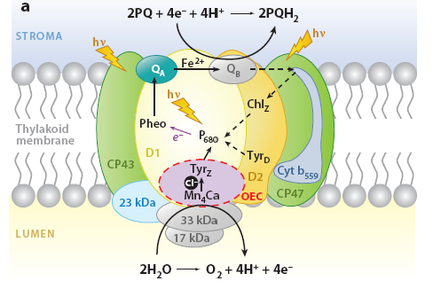
Bio-inspired Artificial Photosynthesis
Fuel formation
Fuel formation
4 H⁺ + 4 e⁻ 2 H₂
Proton-Reduction Catalyst
hν
e⁻
Artificial photosystem
e⁻
Water-Oxidation Catalyst
Key problem:
Water splitting
2 H₂O O₂ + 4H⁺ + 4e⁻
Water splitting
Water splitting
Natural Photosynthesis
Artificial Photosynthesis
14

Slide 15
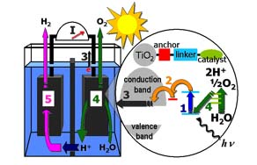
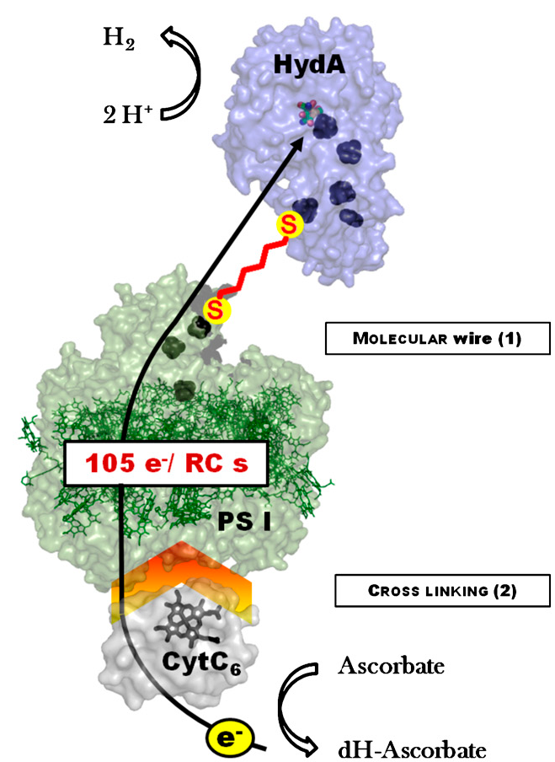
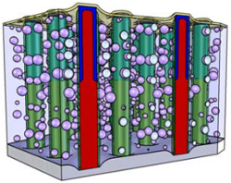
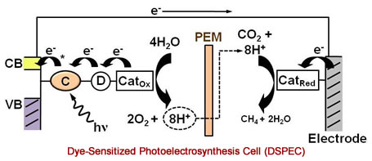





We’re not working alone
Visible-light semiconductor electrolysis | Molecular assemblies | Biohybrid systems

Slide 16




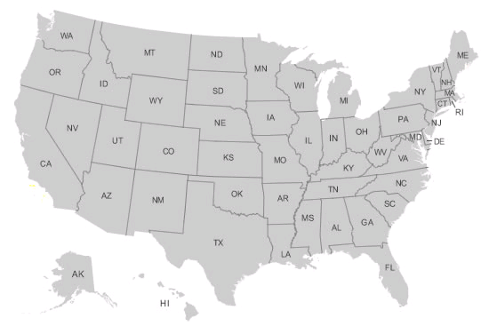










CCI Principal Investigators
Shannon Stahl
Kyoung-Shin Choi
Jenny
Schuttlefield
Paula Hammond
Kit Cummins
Bruce Parkinson
Giulia Galli
Dave Britt
Dan Nocera
Tom Jaramillo
Ray Schaak
Harry Gray
Bruce Brunschwig
Jay Winkler
Jonas Peters
Sharon
Hammes-Schiffer
Jorge Colón
Dino Villagrán
Al Bard

Slide 17

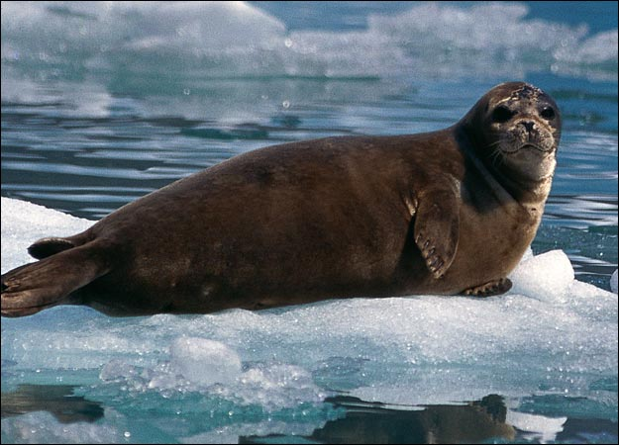
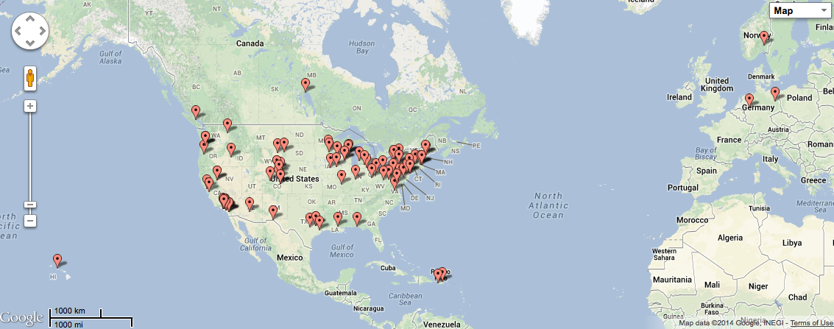
SHArK & SEAL Sites
93 US Colleges & High Schools
5 International Sites
2014

Slide 18
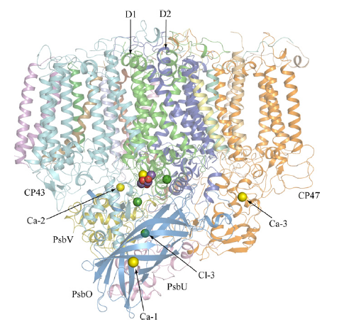
Inspiration from photosystem II
2H₂O + 2PQ + light → O₂ + 4H⁺ + 2PQH₂
Nature’s solution to water-oxidizing chemistry.
Shen, et al., J. Photochem. Photobiol. B: Biology, 2011, 104, 9-18.
Thorp and Brudvig, New J. Chem., 1991, 15, 479-490.

Slide 19
Photosystem II: Nature’s sole method of catalyzing water-oxidation.
Figure: Katherine Shinopoulos, based upon PDB structure 3bz1
Zouni and Saenger, Nat. Struct. Mol. Biol., 2010, 16, 334-342.

Slide 20
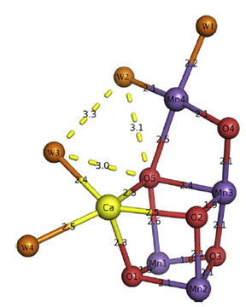
Nature’s oxygen-evolving complex
Active site: a Mn₄Ca oxo-bridged cluster with mostly carboxylate ligation and a local base (R357).
Eº (P₆₈₀⁺) = 1.25 V vs. NHE
Oxygen evolution occurs down to pH 5.
Eº′ (pH 5) = 935 mV
Therefore, “overpotential” for natural oxygen evolution is less than 300 mV.
Even the best manganese oxides have an overpotential of around 560 mV.
TOF ~ 100 mol O₂ (mol OEC)⁻¹ sec⁻¹
[M=O]^{n+} + 2H₂O → [M-OH₂]^{(n-2)+} + O₂ + 2H⁺ + 2e⁻
McEvoy and Brudvig, Chem. Rev., 2006, 106, 4455-4483.
Ferreira, et al., Science, 2004, 303, 1831.
Shen, et al., Nature, 2011, 473, 55-60.
Dau, Zaharieva, et al., Energy Environ. Sci., 2012, DOI:10.1039/C2EE21191B

Slide 21
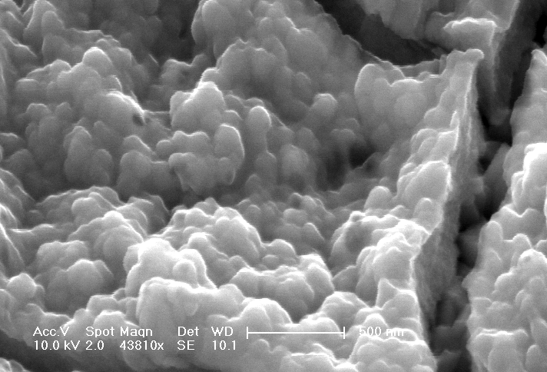
Metal oxides for energy conversion
Iridium oxide material from: Blakemore, et al., Inorg. Chem, 2012.
Notes:
Peaks and valleys

Slide 22
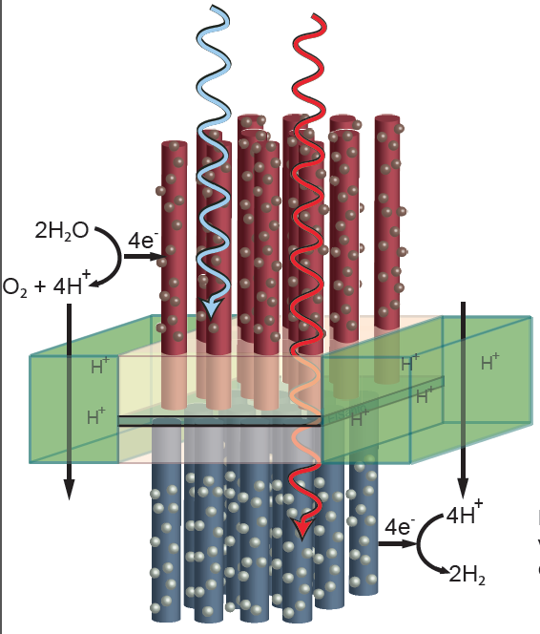
A device for overall water splitting
Figure: Liz Santori

Slide 23

so let’s do it!
thanks

