Slide 1
A solar energy activity developed at the California Institute of Technology

Slide 2
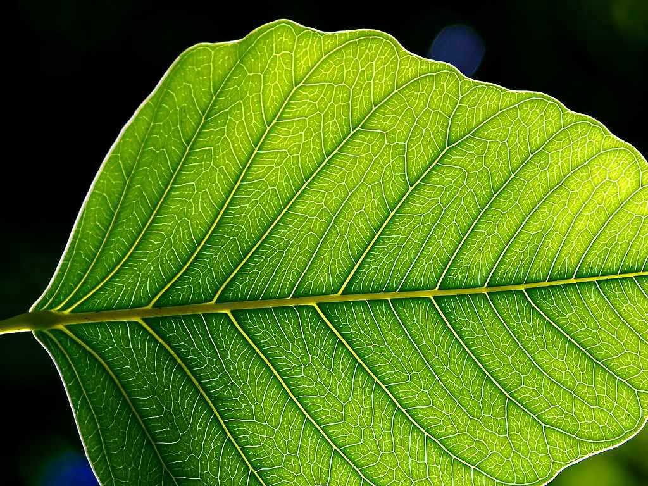
What is a solar cell?
THINK-PAIR-SHARE
A solar cell is a device that collects solar energy and converts it into electricity
Notes:
When I start this presentation, I want students to be involved from the start. This discussion question is a simple way to get students talking to each other and activate their preexisting knowledge on solar cells. I try to relate future slides to facts students typically know about solar cells (ex. What color are the solar panels you see on roofs? Why are they that color?).

Slide 3
We can break down what solar cells do into three steps:
Absorption of light
Conversion of light into moving electrons (we call this electricity!)
Collection of electricity to power our world
Notes:
Students in middle and elementary school don’t always come up with the first point (absorption) by themselves. I try to prompt them to think about what needs to happen when light hits a solar cell. The next steps will typically need to be explained a bit more in depth.
A note on definitions: I also like to emphasize that electricity is just moving electrons. This connection will help students as they move through future science classes.
Analogies and terms I use to describe these concepts:
Absorption – just like a sponge absorbs water, the dye absorbs light (photons)
Conversion – semiconductors are a special material that are used in smartphones, computers, etc. they are converters that turn photons into electrons
Collection – in order to use the electricity we make with a solar cell, we must also collect it. To collect energy, we must make a complete circuit to give the electrons somewhere to go and some work to do.
Physics connection: the cell has potential energy. If we don’t make a complete circuit, that potential is never used; it is not converted to kinetic energy. This is like putting a ball at the top of a hill and never letting it roll down.

Slide 4
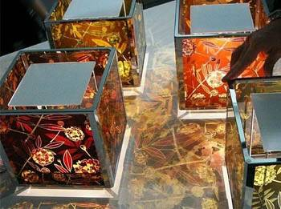
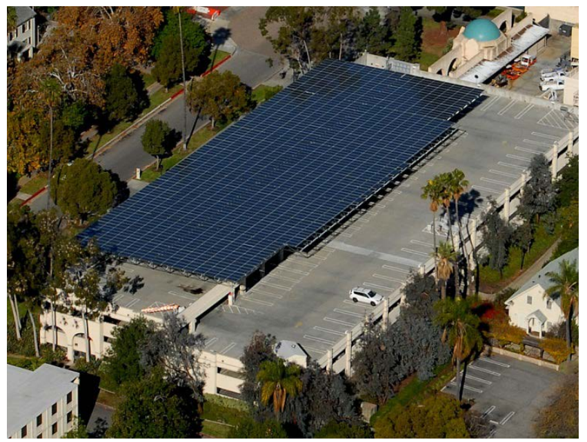
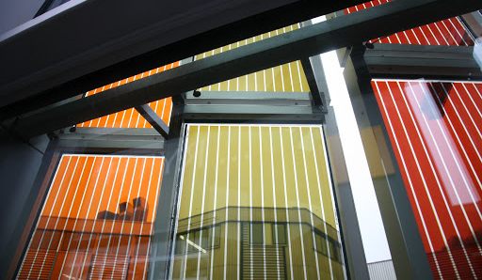
What do solar cells look like?
These are solar panels at Caltech!
silicon solar cells vs. organic solar cells
Notes:
Before I show these pictures, I like to ask students to tell me what color solar panels they’ve seen have been. High school students have typically seen a number of panels or may even have some on the roofs of their homes.
Organic solar cells are the type of cell we make in Juice from Juice. In the teacher’s workshops and with advanced high school classes, I will call these “dye-sensitized solar cells” (DSSCs). Remember that dye sensitization is just the term we use to clarify that the solar cell uses a dye (blackberry juice in these cells) to allow absorption of light.
The cells shown here are very colorful! The benefit of DSSCs is that we can make them any color of the rainbow. I always point out to students that, not only are the organic solar cells on this slide colorful, they can also have designs and are usually transparent. This difference from the rigid structure of a silicon solar panel allows DSSCs to be used as windows on buildings and in flexible solar panels.

Slide 5
How does an organic solar cell work?
Just like in silicon solar cells, we need to do three things:
ABSORB light
CONVERT light into electrons (electricity!)
COLLECT the electricity to power our world
Notes:
Here I think it’s important to emphasize that all solar cells share commonalities in how they work. While the detailed mechanisms for each type of solar cell may differ, the overall concepts are the same. We still need to make a cell that absorbs, converts, and collects.

Slide 6
We need to do three things:
ABSORB light
This slide is coated in white material.
THINK-PAIR-SHARE
Does white material absorb light or reflect light?
WHITE material reflects light.
This slide is NO good for a solar cell!
Notes:
In the following slides, I break down each of the steps according to how they related to the Juice from Juice demonstration.
First is absorption. When I present this to students, I hold up a white slide and walk around the classroom to let all the students see it up close. The schematic on this slide represents the white slide (titanium dioxide coated on a conductive glass substrate, although I don’t mention that to them at this point).
If you’d like to have another short discussion question for your students or students are not participating well, I include the next question as an additional think-pair-share activity. Some students struggle to remember if white material absorbs or reflects light. The most effective prompt to help them remember is asking “what would you wear on a hot day? A black shirt or a white shirt?” It’s also helpful to ask them if a cement basketball court or blacktop is warmer on a hot day.
After the students come to the conclusion that the white slide would reflect light, I ask them if that slide would be a good part of a solar cell. I usually hear a resounding “no!” from the students.

Slide 7
We need to do three things:
ABSORB light
We can make this slide absorb light by adding a DYE to it.
Today our dye will be blackberry juice!
Notes:
From the discussion on the previous slide, students should agree that if we want the slide to absorb light, it needs to be a dark color, just like the solar panels discussed before. I still haven’t told students what the material I’m using is. That explanation will come when I talk about conversion.
At this point, I show the class how to squish a blackberry in a bag with some water to extract the blackberry juice dye. I’ll drop the slide into the bag and set it to the side to soak while I explain conversion to the class. The slide can sit in the blackberry juice for as long as is reasonable for your class period. The longer it soaks, the darker the slide! However, you can use the slides after about 5 minutes of soaking with no issues.

Slide 8
So far we have ABSORBED light. Now we need to
CONVERT light into electrons (electricity!)
Remember the white slide from before?
That white material is special. It’s called
TITANIUM DIOXIDE
TITANIUM DIOXIDE is a semiconductor.
It automatically converts light into electrons
(electricity!)
Notes:
Now, I explain the second step to students along with what the white material is. In an organic solar cell (a DSSC), absorption of light and conversion of that light to electricity happen in two different materials that are placed adjacent to each other. In a silicon solar cell, these two processes happen in one material – the silicon.
Silicon is a semiconductor. Semiconductors can convert light into electricity. Absorption of light, which is really just energy from the sun, excites electrons in the semiconductor to a higher energy level. At higher energy levels, those electrons now have enough energy to do work (power a lightbulb, computer, etc.) if we give them somewhere to go.
When I explain this to students, I usually just call a semiconductor a “converter” and leave it at that. Remember this process is the same as raising a ball to the top of a hill. We give the electrons potential energy (the ball is at the top of the hill). If we construct the solar cell correctly, that energy does work for use (the ball roles down to the bottom of the hill).

Slide 9
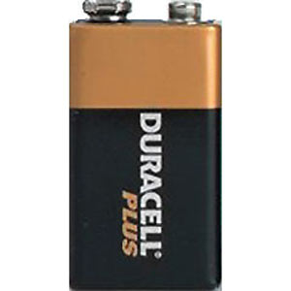
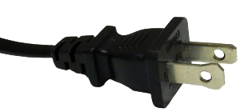
What’s our final step? We need to:
COLLECT the electricity to power our world
Just like in the power cord and the battery, to collect these electrons we need to give them somewhere to go.
We need to make a complete circuit.
Notes:
At this point, it’s important to remind students that our work as scientists is not done quite yet. Just one slide is not enough to make a solar cell, which brings us to the second half of the cell.
To justify the creation of the second half of the solar cell, I remind students that all the electronic devices they encounter on a daily basis must form complete circuits to work. When you look at a power cord, it has to have two prongs (or three for some grounded devices) to work. Similarly, a battery has two terminals. You need to connect to both to make a system run.
To successfully make the second side of the solar cell, students need to identify which side of a piece of glass is conductive. First, I ask students if glass is normally considered a good conductor. Most student know that glass is an insulating material. We don’t expect windows to conduct electricity! The glass we’re using in this experiment is a coated with a special layer of conductive material on one side. This coating is fluorinated tin oxide (FTO).
Students can identify the side with the FTO by determining the glass’s resistivity with their multimeters (set to the 200 Ω setting, arrow pointing straight down). By touching both leads to one side of the glass, students will either get a reading of 1 (overload, a number SO big the device can’t even register how big it is) or a number between 30 and about 100, although higher numbers are fine too. The side with the reading between 30-100 Ω is the conductive side of the glass.
I demonstrate this procedure for the students. It’s important that they see it up close to see that both the red and black leads must touch the glass to get a reading. Since resistivity is frequently new concept for a lot of students, it’s a good idea to explain that resistivity has the root word of resist. We aren’t measuring conductivity directly; we’re actually measuring the glass’s resistance to the flow of electrons. A low resistivity (the reading between 30-100 Ω) indicates a low resistance to flow, which in turn means good conductivity. Conversely, a high resistivity means a material has a low conductivity.
Analogies for resistivity:
High resistivity – the electrons have a large wall to get over when resistivity is high. There is a big barrier to the flow of electrons (current) from one place to another. It’s hard for a lot of electrons to make it over the wall. Only a few do make it over so the flow of electrons (current) is small.
Low resistivity – the electrons have no barrier to movement. This situation is like an open freeway with no traffic! It’s very easy for electrons to move through a system with low resistivity.

Slide 10
What’s our final step? We need to:
COLLECT the electricity to power our world
To complete the circuit, we need a second half to our cell.
We will use pencil lead (graphite) to make this glass conductive.
Notes:
Once students have determined which side of the slide is conductive, they need to improve the conductivity of the cell beyond what the layer of FTO does. This step is important, because the conductive glass alone is good at conducting laterally through the slide but not out from the slide. When the students scribble graphite all over the surface, they improve the conductivity out of the slide.
Encourage your students to thoroughly coat their slides with graphite. More graphite will greatly improve the current reading students will see when they test the cells in the sun.

Slide 11
What’s our final step? We need to:
COLLECT the electricity to power our world
Now we need to put our cell together.
Notes:
At this point, I fish the dyed slide out of the blackberry juice bag and rinse any pieces of blackberry back into the bag with a squirt bottle. When students do this at their desks, the tweezers can be a little tricky for them to handle. If it’s easier, you can have students grab the slides out with their fingers, but remind them to hold it by the edges only! We don’t want anyone to accidentally wipe the titanium dioxide off the slide.
CRITICAL: For high performance cells, this slide must be thoroughly dried by the next steps. Water will severely impair the performance of the cell by diluting the conducting liquid (electrolyte) that we add to complete the cell. Pat the cells dry. Don’t rub! That will remove the titanium dioxide.
Students have now created the two halves of their cells. To allow for the final step of collection, they need to fully assemble their cell. I like to call this the “Juice from Juice sandwich” when I demonstrate this in front of the class. All the good stuff in a Juice from Juice sandwich is on the inside, just like in a peanut butter and jelly sandwich. This sandwich means that the dye-soaked side of the first slide and the graphite-coated side of the second slide face each other to make the sandwich.
I recommend that you ask your students to double check that the two conductive sides of the glass are facing each other. If they want to be completely sure, students can use their multimeters to check each slide for conductivity. When they do this measurement on the dye-coated slide, make sure they place the red and black leads on the clear part of the glass, not on the dye, otherwise the multimeter won’t read the correct value.
As the final picture here shows, the slides should not be placed so that they completely overlap with each other. In order to test the cells, the students should offset the slides so that each edge has an overhang for the alligator clips. The binder clips go on the side with NO overhang. Make sure that students are placing the binder clips at the edges of the slides. If the clips cover the slides, the cell will absorb very little light when the students test them.

Slide 12
What’s our final step? We need to:
COLLECT the electricity to power our world
electrolyte goes here
We add electrolyte (conducting liquid) to the gap between the two slides
Notes:
The final step is to add in a few drops of electrolyte – or conducting liquid. Students have typically heard about electrolytes in the context of sports drinks. Electrolytes are just ions. By adding an electrolyte solution (iodide/triiodide), we allow the two sides of the solar cell to pass electrons from one side to the other. I like to compare the slides without this conducting liquid to two people on opposite sides of the globe. They have the ability to talk, but without a cell phone or computer, they can’t talk to each other. In the same way, the two slides without electrolyte solution can not “talk;” they cannot move electrons between the two sides of the cell.
It’s helpful to point out where the electrolyte will go by walking around the classroom and indicating the gap between the slides. This gap is had to see from far away so I walk around the classroom to each group to point it out.

Slide 13
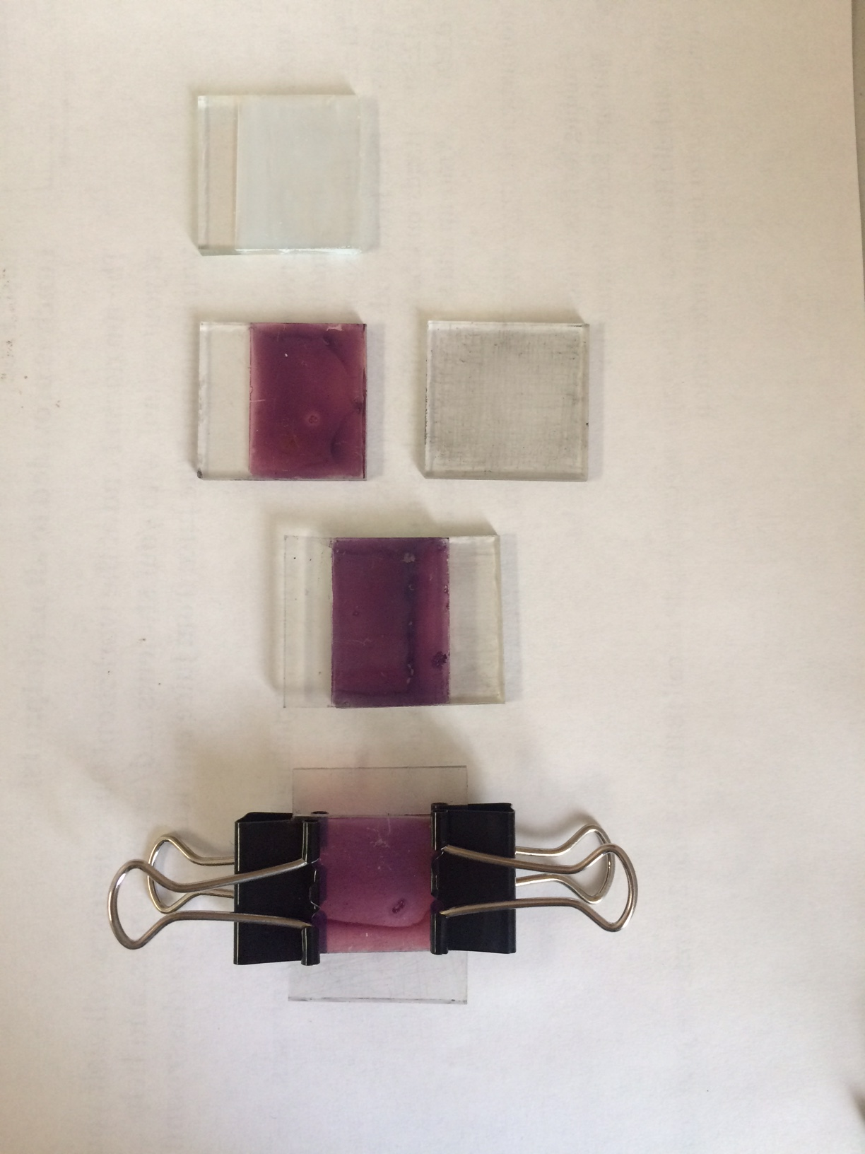
Juice from Juice organic solar cells
Dyed titanium dioxide
Sandwich layers
Complete
cell
Titanium
dioxide
layer
Pencil lead (graphite) layer
Notes:
Once students get to this point, they can go outside and test their cells. They will measure potential (in millivolts – mV) on the 2000m setting on the multimeter. After recording their potential measurements, students should switch to the current setting (2000μ on the multimeter) and record the highest number they see.
These are also good pictures to leave up after presenting to remind students what all the pieces of the cell along with the final product should look like.

Slide 14
Energy Levels of DSSCs
Although we’ve spatially rearranged the energy levels, they still sit at the same energies!
LUMO
CB
HOMO
LOAD
I⁻/I₃⁻
VB
Notes:
The next two hidden slides are yours to use or skip as you wish. These slides provide more details on the electron movement through the DSSC. If you went to one of our teacher workshops, you probably saw these slides during the presentation.

Slide 15
Energy Levels of DSSCs
The electron ‘rolls’ down the potential hill, passing through the load, and returns to the ground state in the dye.
LUMO
CB
e-
HOMO
I⁻/I₃⁻
LOAD
DYE
VB
TiO₂

Slide 16
Data from Today
Cell | Potential (mV) | Current (μA) | Power (nW)
Average
Power = Current * Potential
P = I*V
Notes:
If you’d like, you can record everyone’s results in this table and get the class average for potential, current, and power.
Remember we calculate power as the product of potential and current:
Power = potential * current
P = I * V

Slide 17
Learning objectives
At the end of today’s demonstration, you should be able to:
communicate how a dye-sensitized solar cell (DSSC) converts light waves into electricity
design and build a dye-sensitized solar cell from basic components and blackberry juice dye
refine their solar cell design through the comparison of various fruit dyes
evaluate a dye-sensitized solar cell’s performance in comparison to a silicon solar cell
Notes:
These objectives are listed in the DSSC high school lesson plan but are here as well as a reminder of what your students can learn from this activity.

